Slide 1
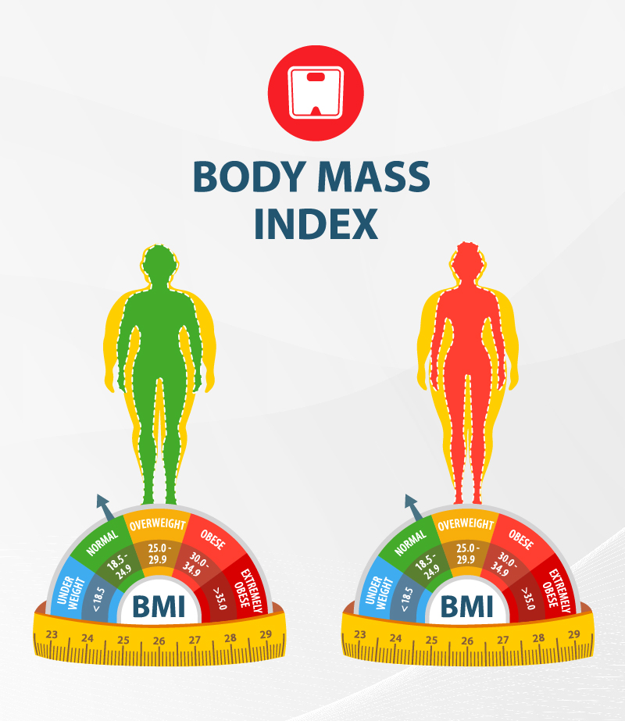


Analyzing Health Profile of Dhaka Cities People in Bangladesh: Employing Python for Statistical Inference and Linear Regression Insights.”

Slide 2
Supervisor
Ms. Farhana Afrin Duty
Assistant Professor
Department of Statistics and Data Science
Jahangirnagar University
Presented By
Salaha Uddin Chowdhury Shaju (ID:20231147)
Mir Khalid Hassan (ID: 20231167)
Md. Habibur Rahman (ID:20231183)
Date: 22nd December, 2023

Slide 3
Out line of the project
Introduction
Objectives
Data collection and Methodology
Data Exploration and Visualization
Result Analysis
Conclusion

Slide 4
Objectives
Primary objective
BMI (Body Mass Index) variations among different population
Secondary Objective
Analyze BMI in terms of Hypertension
Risk factor analyzing concerned with BMI and Hypertension

Slide 5
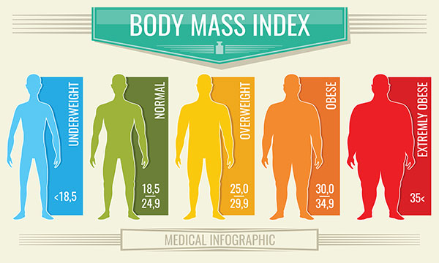
Bmi classification

Slide 6
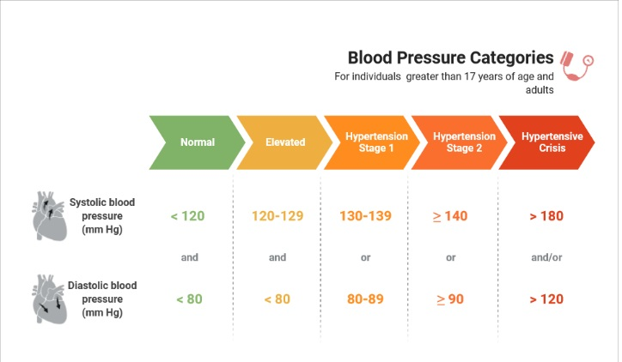
Hypertension stages

Slide 7
Data collection
Source of Data
Data provided by IPDI Foundation
Participant Recruitment
Ethical Considerations
Data Quality Assurance

Slide 8
methodology
Sampling Method
The data was collected using a convenience sample strategy, which targeted persons who actively participated in exercise activities within the chosen park locations. This methodology was selected due to its applicability and effectiveness in gathering perspectives from people who are easily reachable in these leisure spaces.

Slide 9
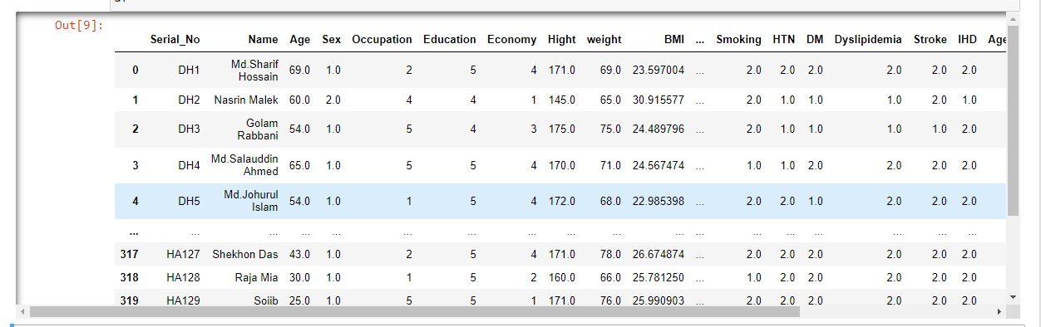
Data Overview
The dataset comprises 22 columns and 322 entries

Slide 10
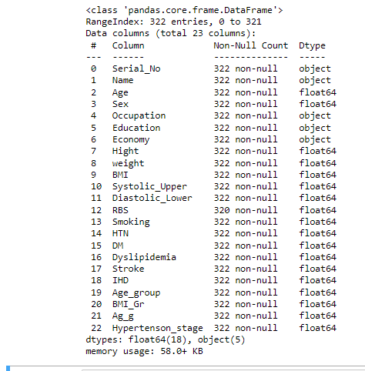
Data summary
Summary Statistics
1. The summary statistics table presents numerical characteristics, including distribution, central tendency, and variability of values.
2. Age ranges from 17 to 83 years, with an average age of approximately 51.12 years.
3. Standard deviations indicate the dataset's variability for each variable.

Slide 11
Data processing
Data Cleaning
During data processing, missing values were identified in the 'RBS' variable (2 entries).
Rows with missing values were removed to ensure data integrity.
The cleaned dataset, labeled as "df1," retains the same columns but may have fewer rows than the original 320

Slide 12
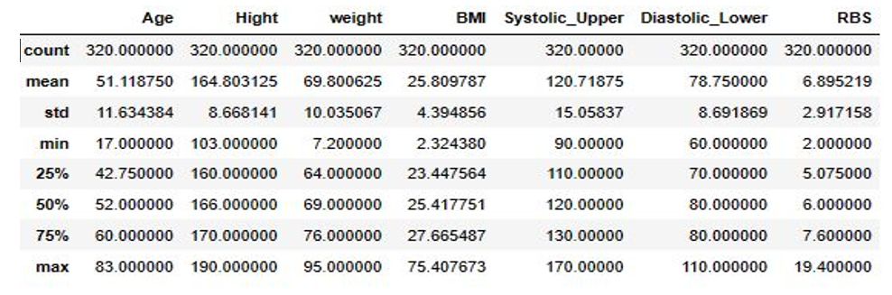
Data processing
Variables in Summary Table

Slide 13
Data processing
Quartile Analysis
1. The 25th percentile (1st quartile) age is approximately 42.75 years, signifying that 25% of participants are younger.
2. The median age is 52 years, providing insight into the central trend of the dataset.
3. Three-quarters of participants fall below the 75th percentile (3rd quartile) age of 60 years.

Slide 14
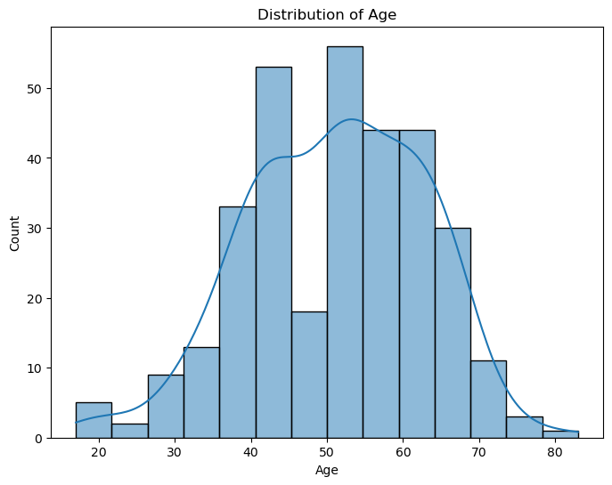
Data visualization

Slide 15
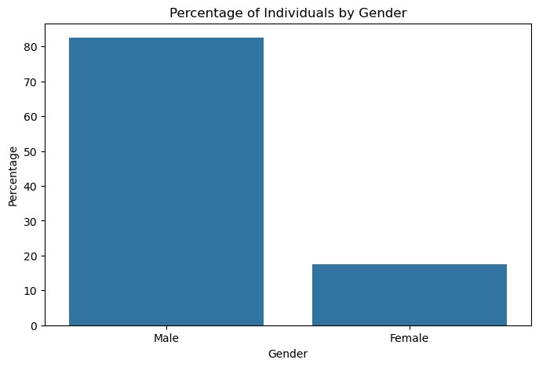
Data visualization

Slide 16
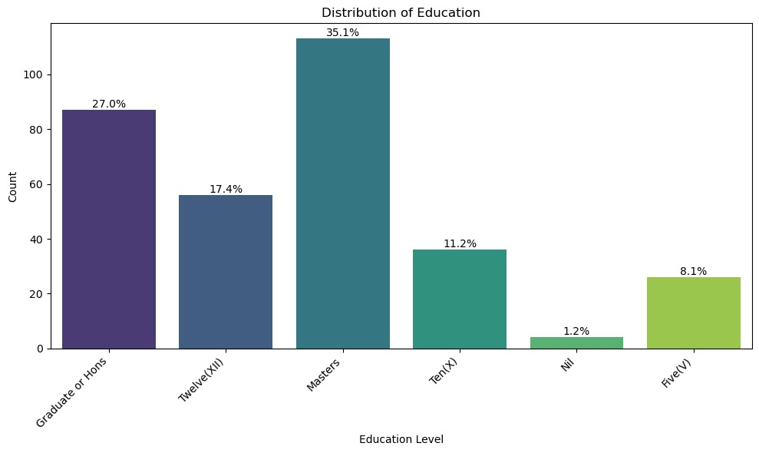
Data visualization

Slide 17
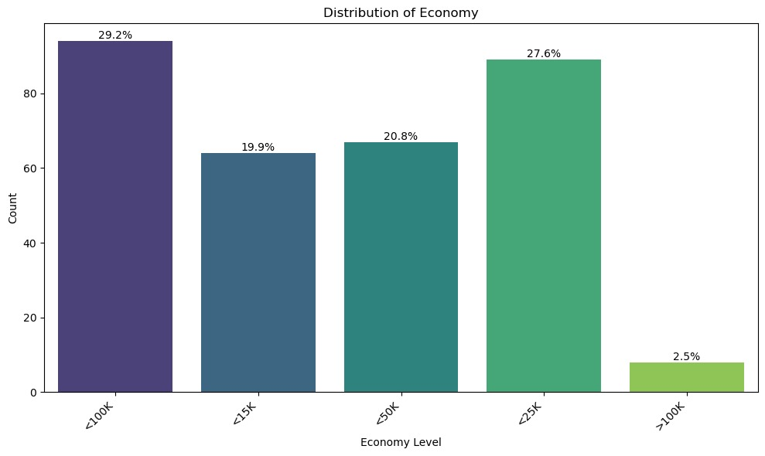
Data visualization

Slide 18
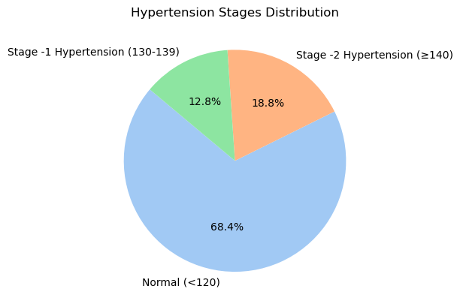
Data visualization

Slide 19
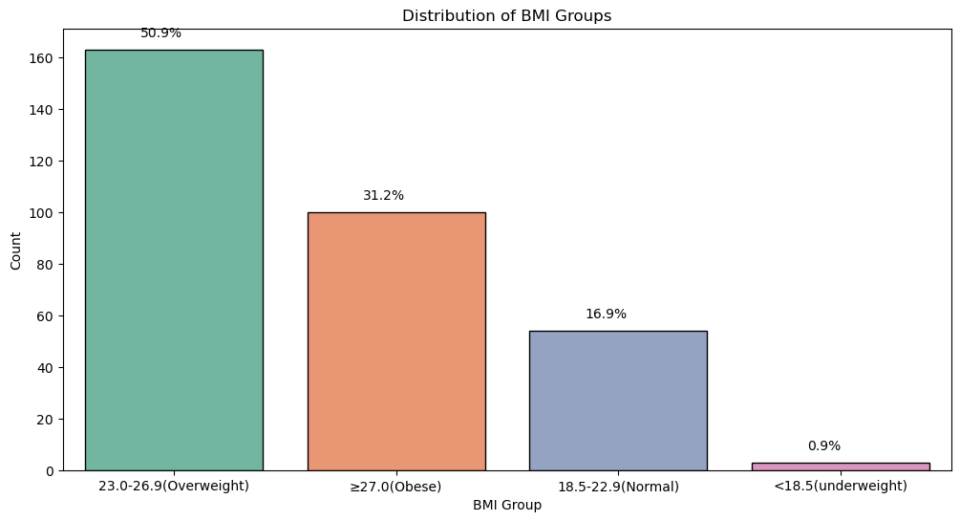
Data visualization

Slide 20
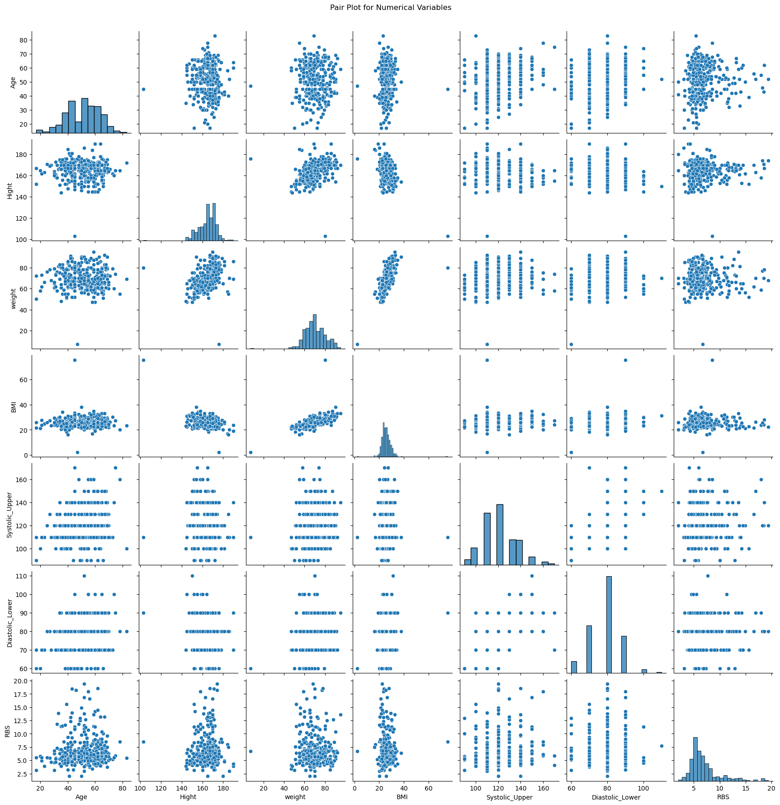
Data visualization

Slide 21
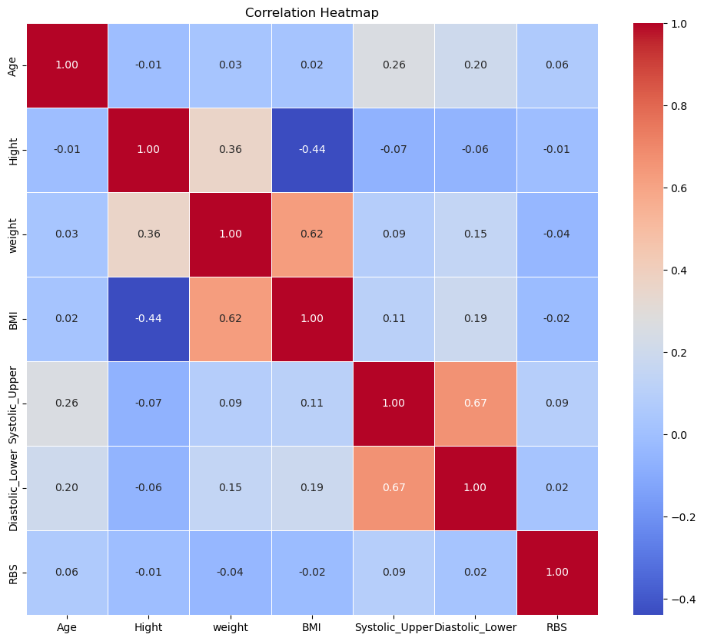
Data visualization

Slide 22
Statistical Analysis

Slide 23
Statistical Analysis

Slide 24
In our investigation, we applied the chi-squared test to explore the relationship between key categorical variables in our dataset.

Slide 25
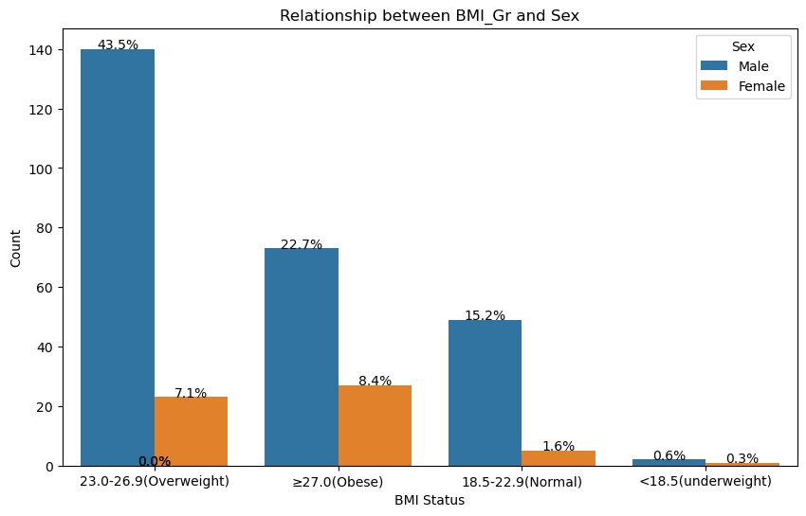
Relationship between BMI Group and Sex

Slide 26
Examine the association between gender and BMI Group
Results:
Chi-squared value: 10.61
p-value: 0.014
Significance Level: 0.05
Interpretation:
There is a significant relationship because the p-value (0.014) is less than the significance level.
There is a significant difference in the BMI category distribution between males and females.
comprehensive clarifications of the complex connection between gender and BMI

Slide 27
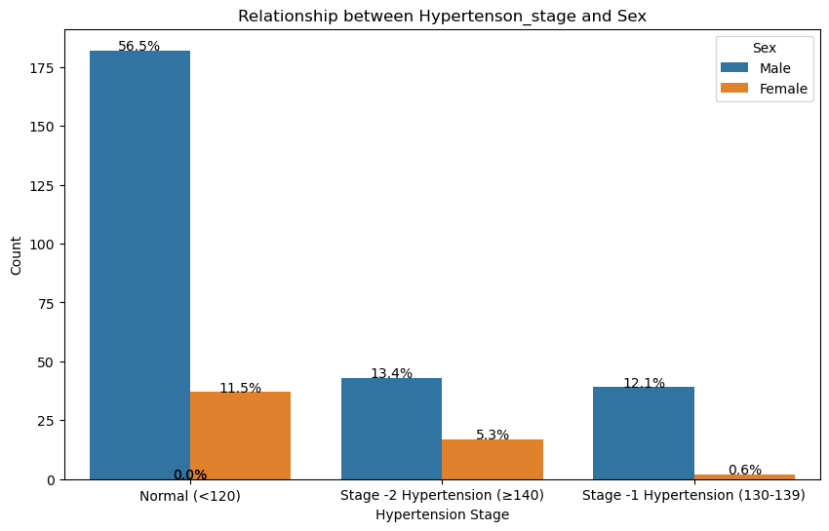
Comparison between Hypertension Stage and gender

Slide 28
Investigate the association between Hypertension Stage and Gender
Results:
Chi-squared value: 9.46
p-value: 0.009
Significance Level: 0.05
Interpretation:
There is an association that is statistically significant because the obtained p-value (0.009) is less than the significance level.
There is significant variation in the distribution of hypertension stages in men and women.
Useful details about the relationship between stages of hypertension and gender.

Slide 29
Insights from Linear Regression
Assess the accuracy of the linear regression model.
Key Metrics:
Mean Squared Error (MSE): 1.14
Interpretation: Average predictions closely align with actual values.
R-squared (R2): 0.884
Significance: Model captures 88.4% of variability in the target variable.
Takeaway:
Robust predictive capabilities of the model.
Effective explanation of observed patterns in the data.

Slide 30
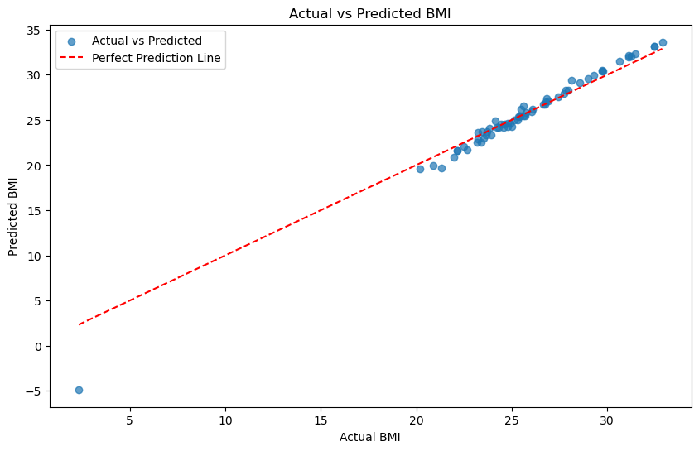
Visualize the linear regression model's output
Well-fitted model observed with a tight cluster of points around the regression line.
Strong correlation between actual and predicted values.

Slide 31
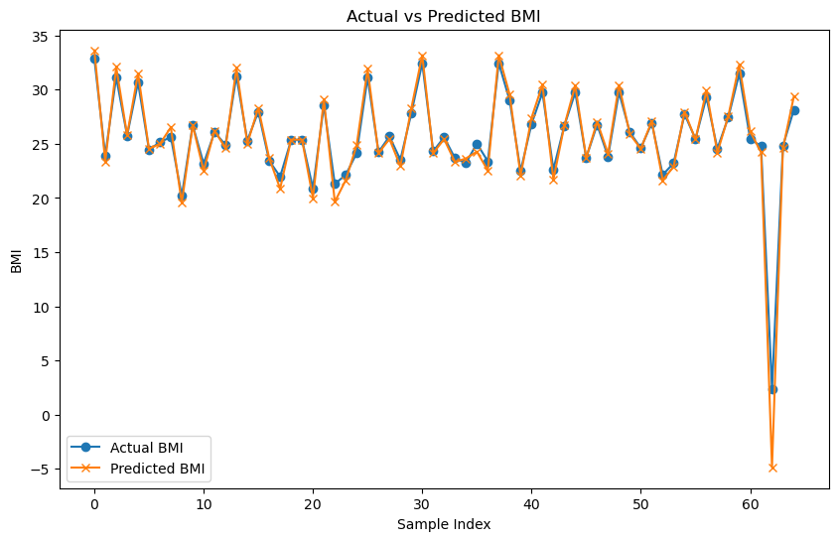
Understand model accuracy through visual representation
Maximum predicted BMI values closely related to actual BMI values.
Model's best fit observed in the line graph

Slide 32
Conclusion
Our study presents a successful development and evaluation of a robust linear regression model for BMI prediction, demonstrating strong performance with an MSE of 1.14 and an R2 value of 0.884. Notably, chi-squared tests revealed significant associations between gender and BMI groups (p = 0.014) and hypertension stages (p = 0.009), emphasizing the relevance of gender-specific considerations in health classifications. These insights contribute valuable knowledge to the interplay between demographic variables and health outcomes. While our study provides a solid foundation, we recognize the potential for further investigation with additional variables and a larger dataset to enhance generalizability. Our research aims to guide healthcare interventions for specific demographic groups, making meaningful contributions to the field of health analytics and warranting consideration for international journal submission

Slide 33

Add a Slide Title - 1

